Slide 1
Probabilistic Social Sequential Model for Tour Recommendation
Vineeth Rakesh*, Niranjan Jadhav*, Alexander Kotov* , Chandan K. Reddy⁺
*Wayne State University, Detroit, MI, USA ⁺Virginia Tech, Arlington, VA, USA.
Presented at ACM WSDM 2017, Cambridge, UK

Slide 2








Busy traveler problem

Slide 3
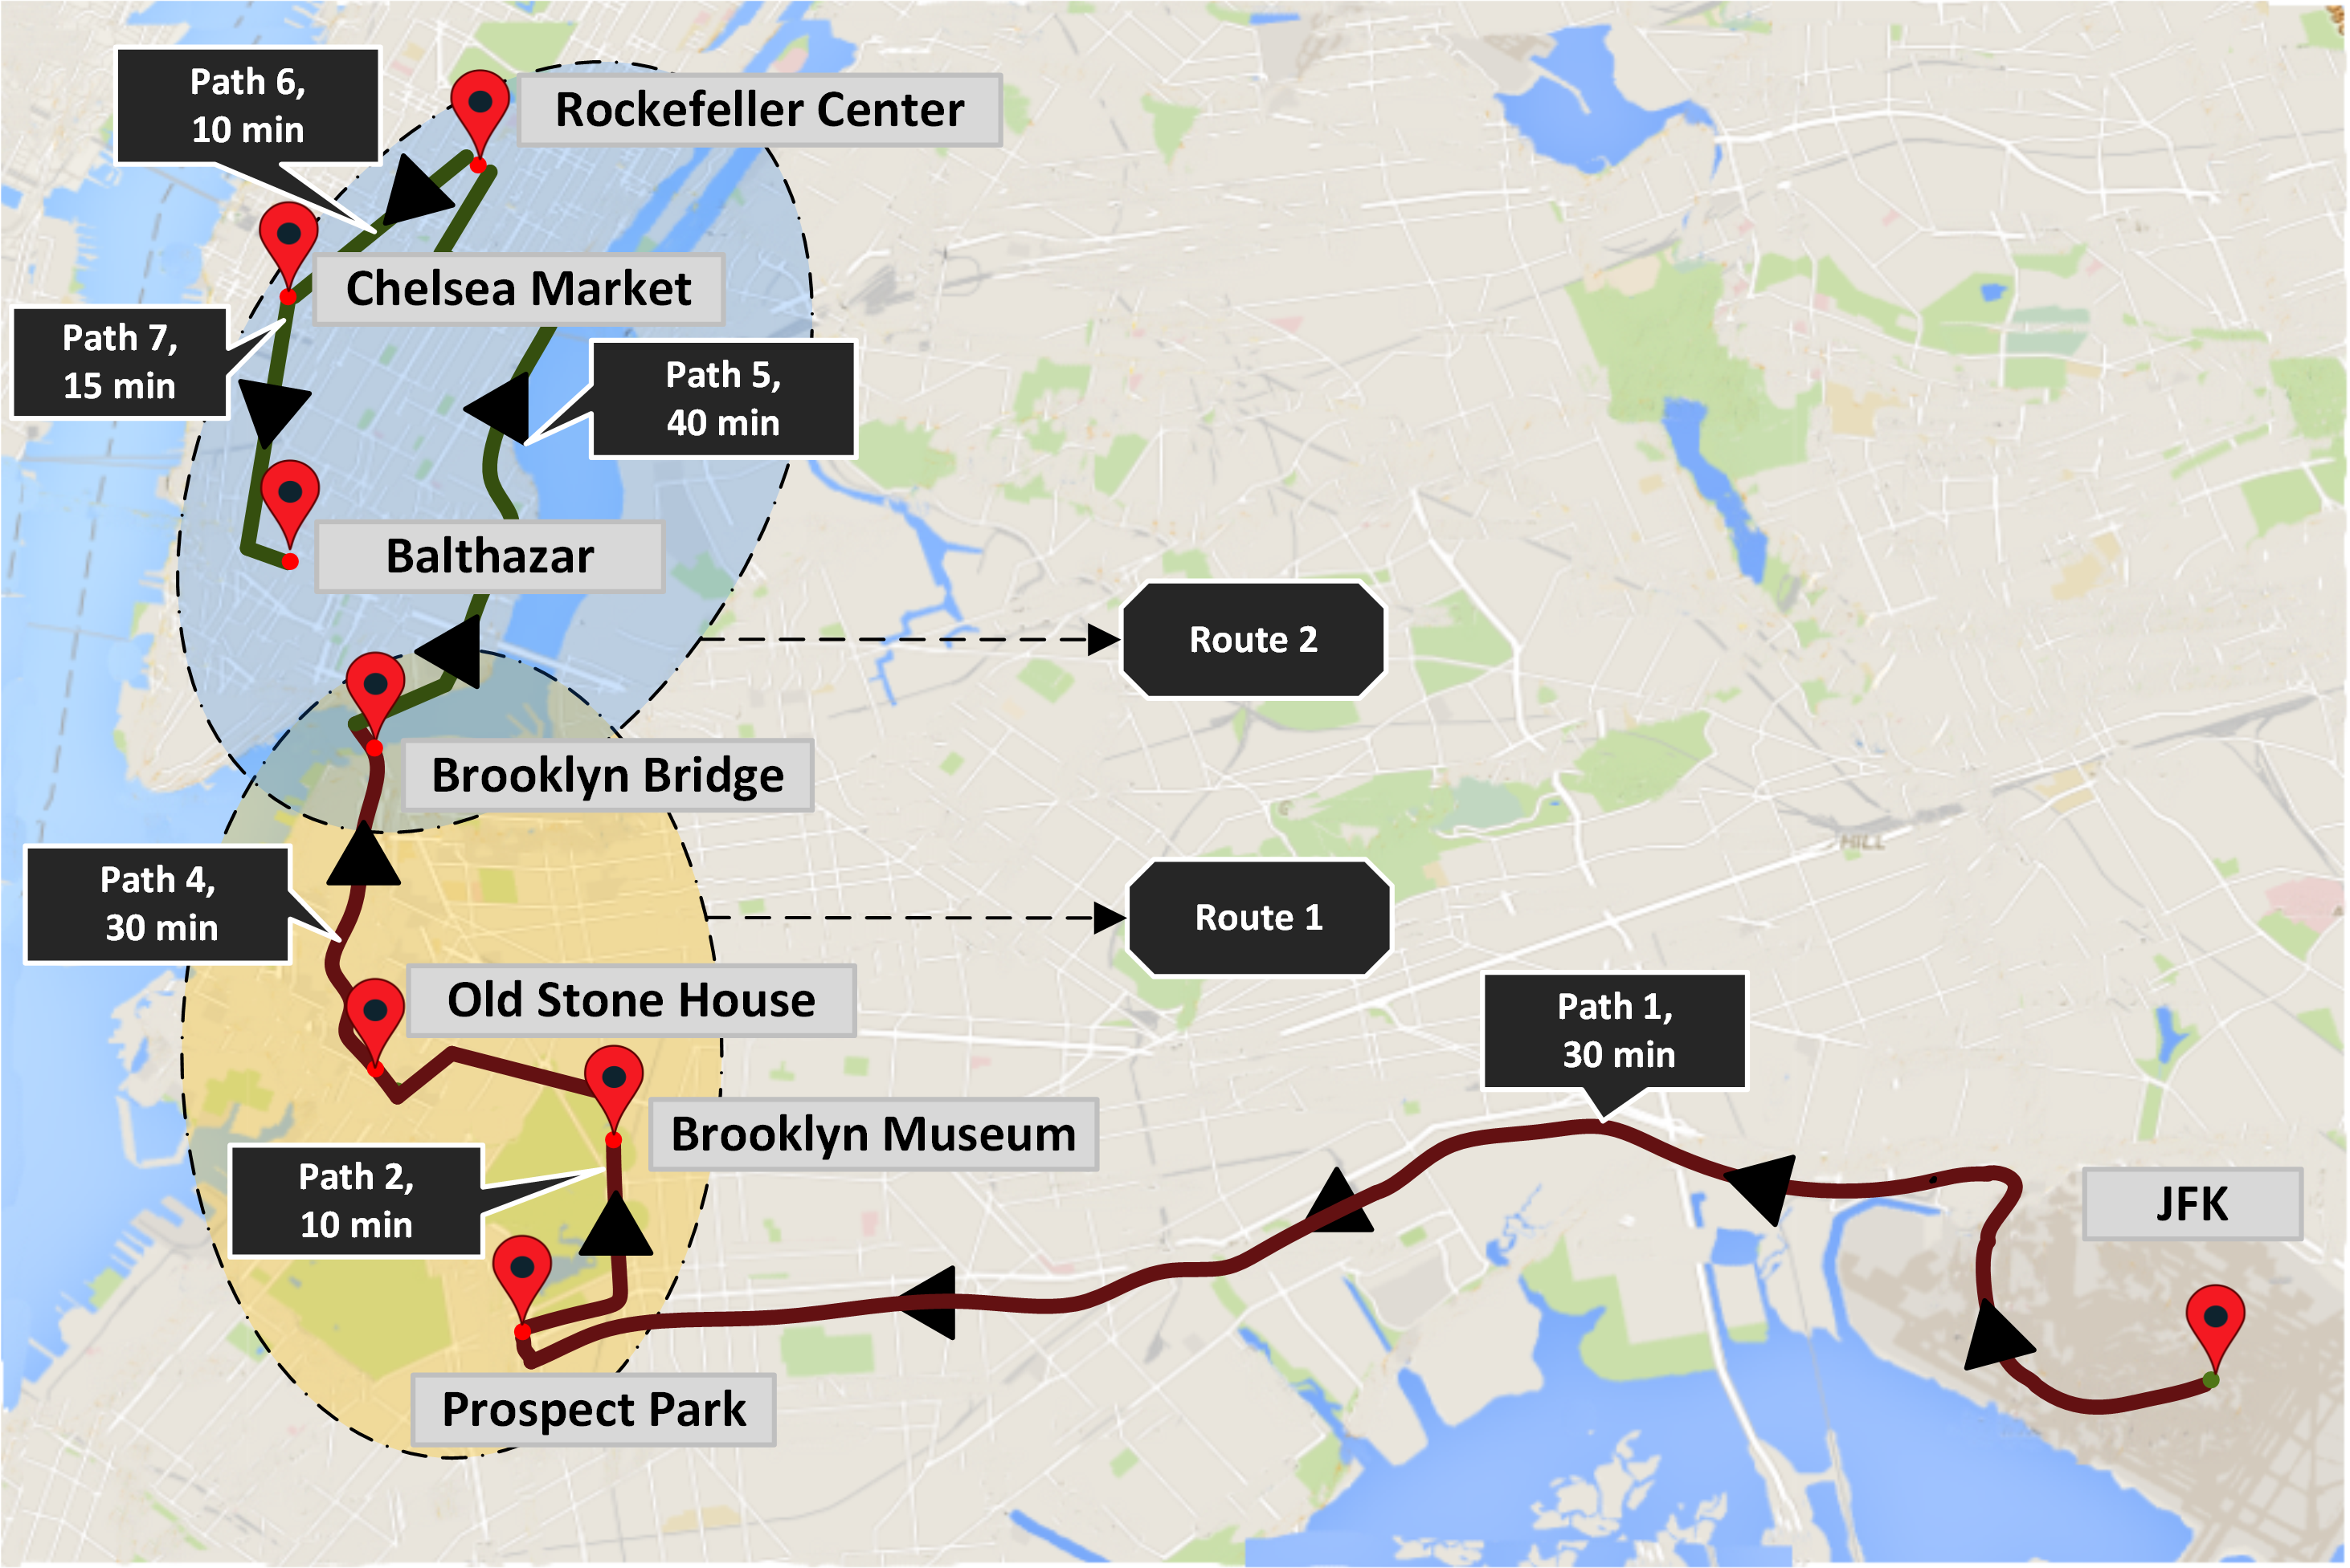
POI Sequence Recommendation

Slide 4
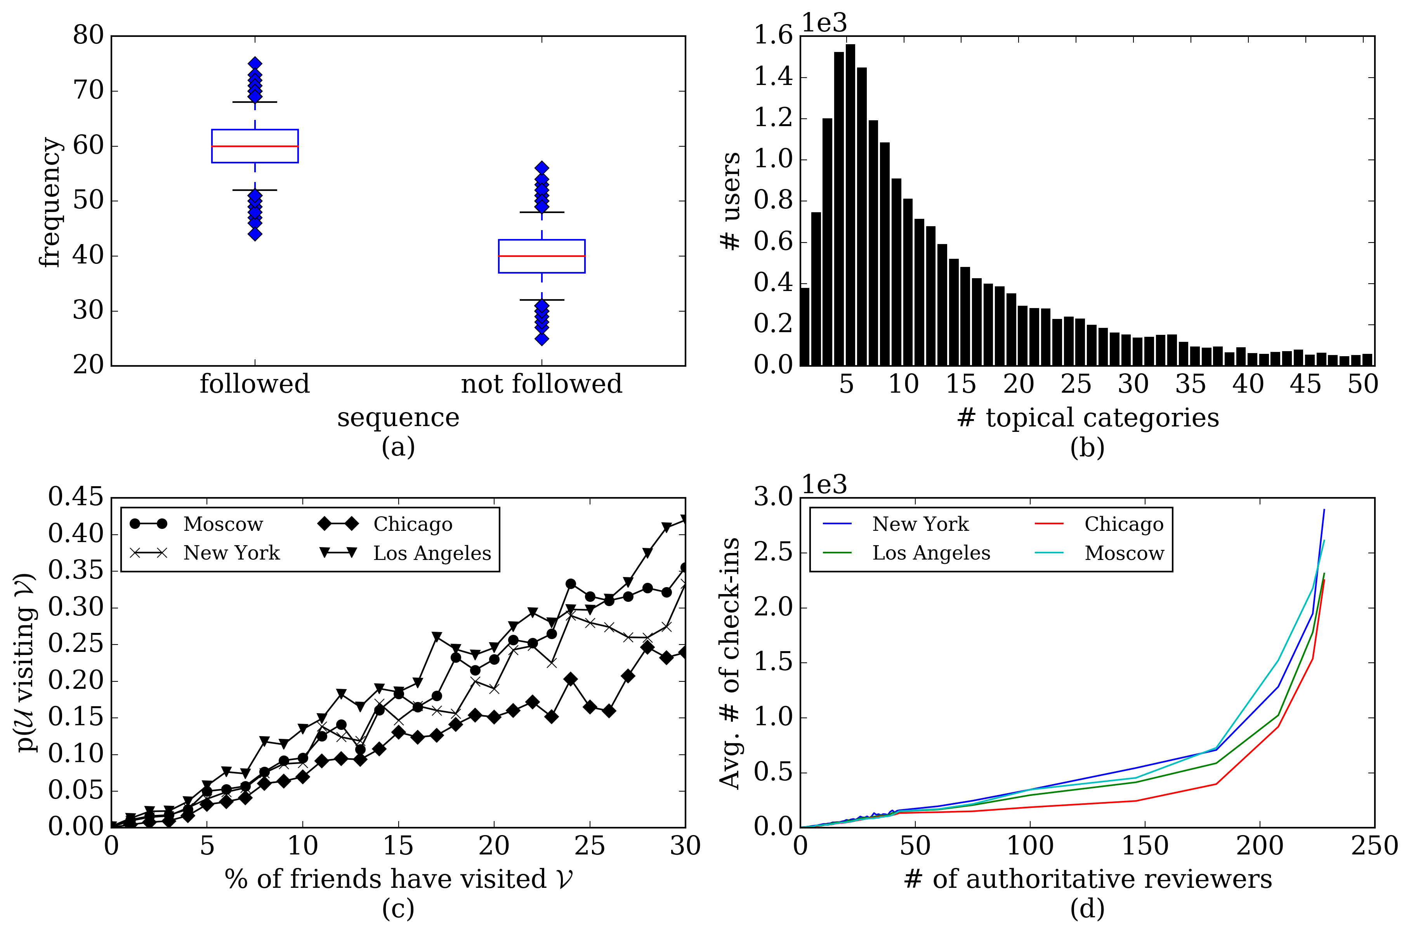
Learning traveler behavior
Impact of Travel Sequence: majority of travelers visit POIs sequentially
Topical Composition: travelers are interested in multiple topical categories of POIs
Impact from the Social Circle: social circle of a user plays an important role in influencing the check-in habits of travelers
Presence of Prominent Reviewers: authoritative users influence travelers

Slide 5
Tour Recommendation: Challenges
Extreme sparsity of Check-in Information: tourists are not native to their destination → simple collaborative filtering based techniques will yield poor recommendation results.
Capturing Human Mobility Patterns: unlike conventional recommendation, temporal features play a critical role in determining the next check-in spot
Capturing user preferences: traveler have habits and prefer to visit certain type of locations
Notes:
Human mobility: Person who visited an Italian restaurant at 12:30pm will mostly likely won’t visit a restaurant immediately although he might like Italian! Or just because two POIs are close by.

Slide 6
Proposed method
Topical preferences of users from their historical check-ins
Their friends’ previous travel-related check-ins
Sequential visiting patterns of travelers
Trending popularity of POIs

Slide 7
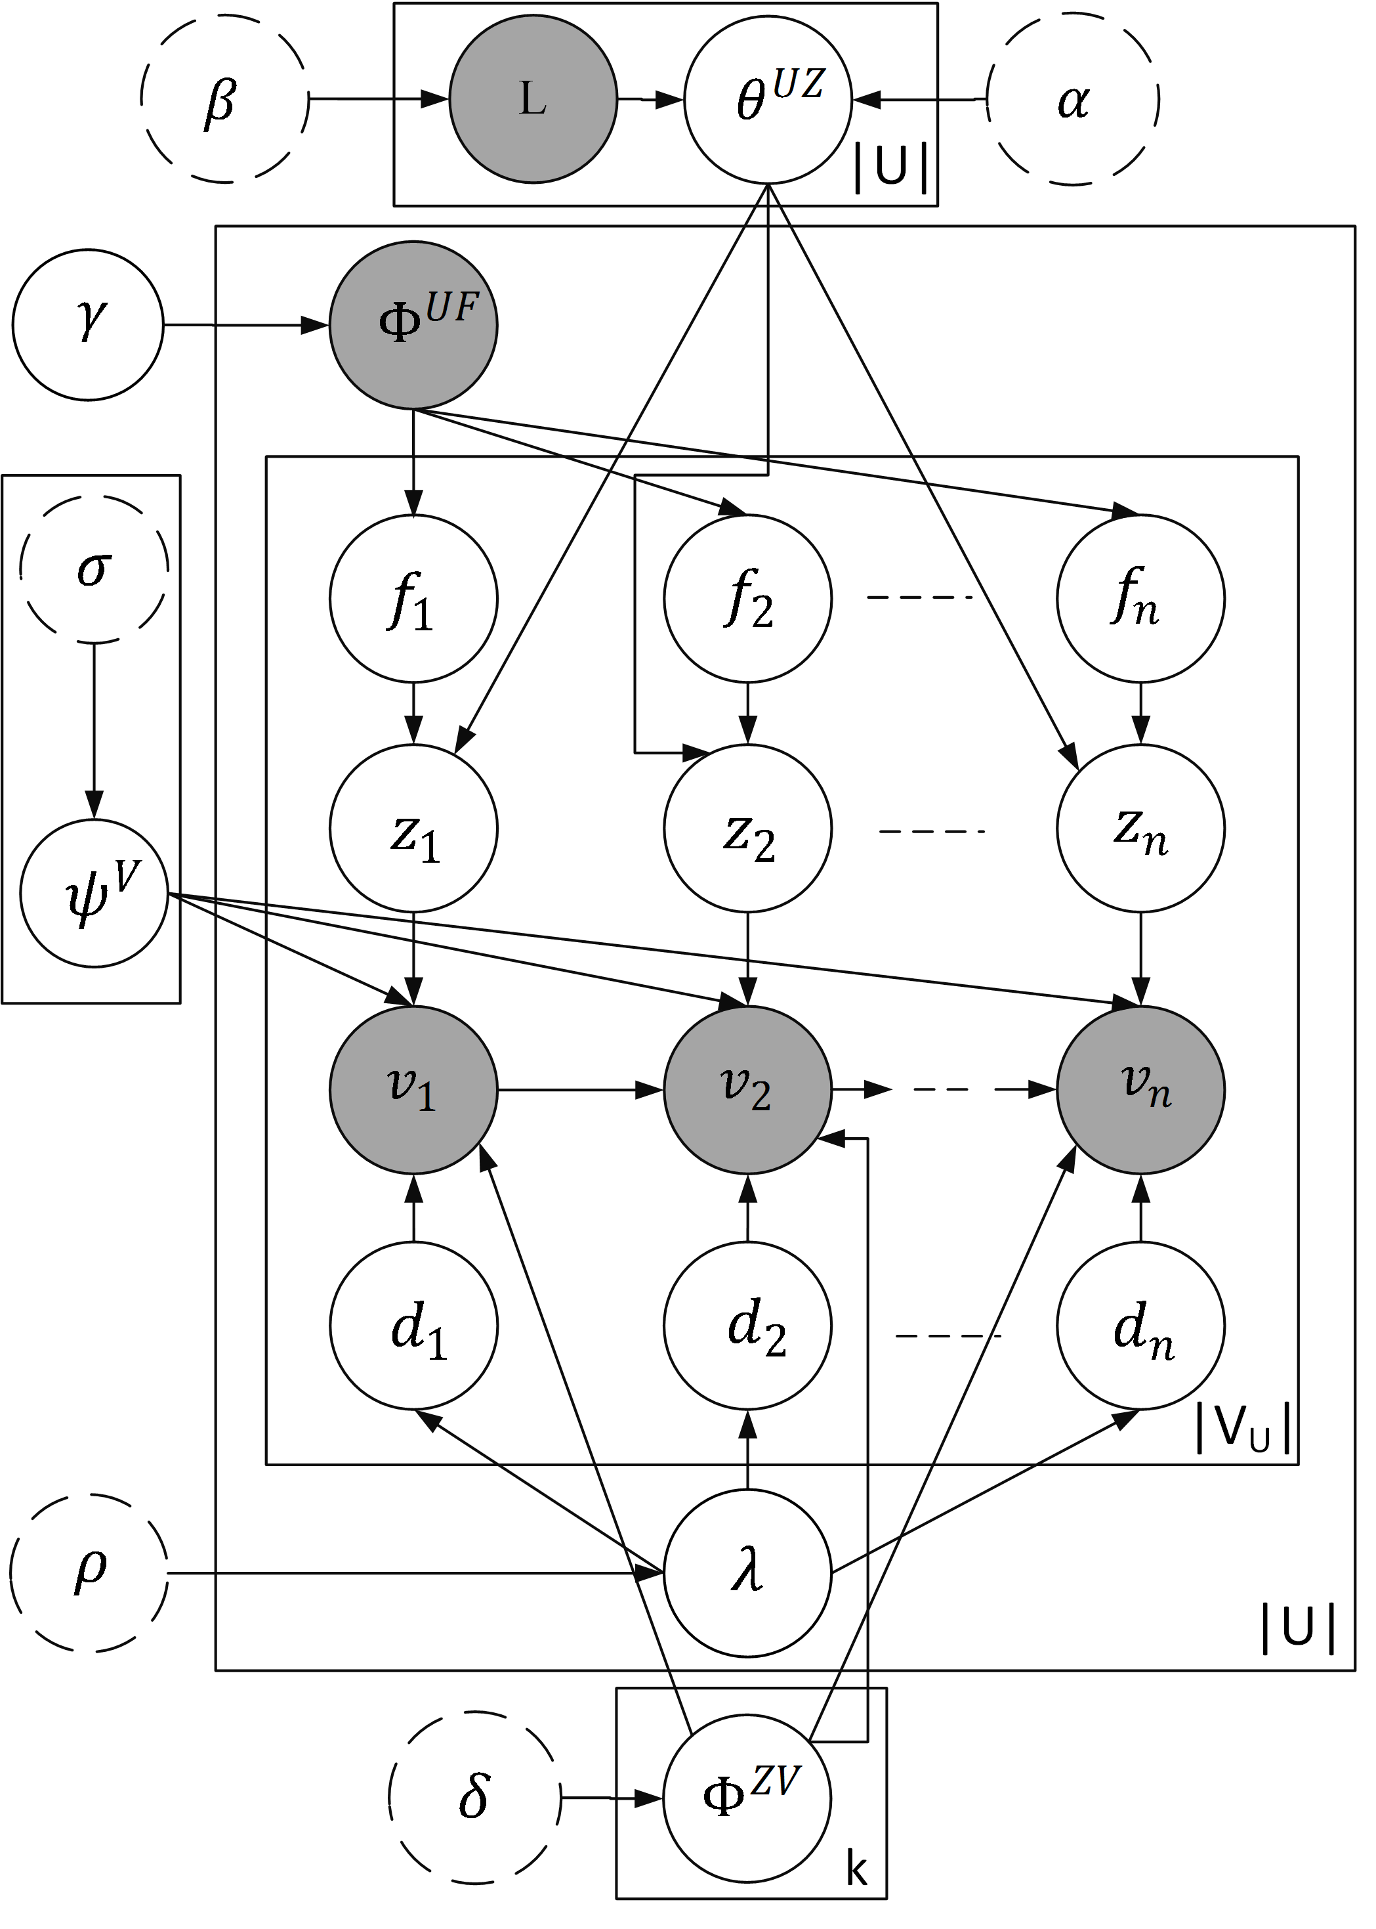
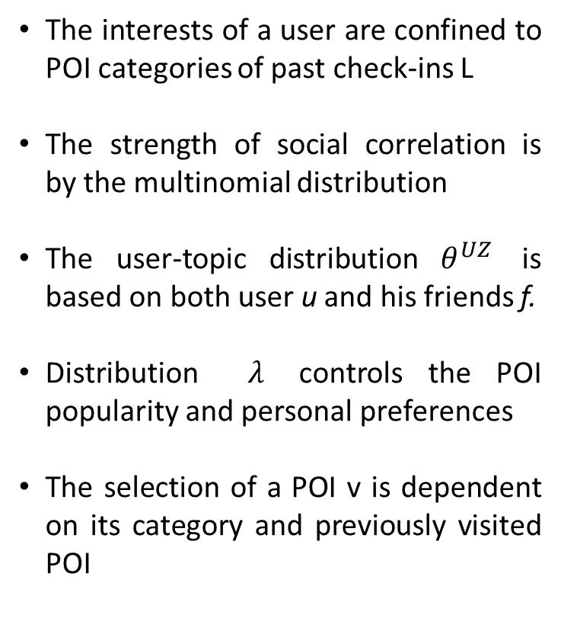

Social Sequential Tour Recommendation Model (SSTREC)
The interests of a user are confined to POI categories of past check-ins L
The strength of social correlation is by the multinomial distribution
The user-topic distribution $θ^{UZ}$ is based on both user u and his friends f.
Distribution $λ$ controls the POI popularity and personal preferences
The selection of a POI v is dependent on its category and previously visited POI
$${ Φ}^{UF}$$

Slide 8
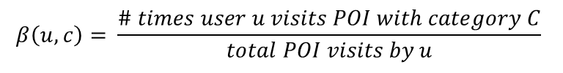
Incorporating POI and Traveler Features
Topic (POI Category) Feature: POI categories from the historical visits of users, which form the supervised topical labels. The prior for POI category distribution is calculated as follows:
Social Feature: prior for distribution of social correlations is linear combination of the following features:
Presence of a friendship link between users
Number of overlapping topical categories (obtained from historical POI visits)
Number of lists that are commonly followed by the users.
POI popularity Feature: Combination of two features (a) number of prominent reviewers for a POI and (b) the total number of check-ins
$$β\left(u,c\right)= \frac{\# times user u visits POI with category C}{total POI visits by u}$$

Slide 9
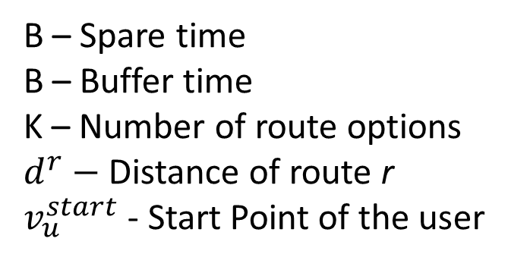
Creating POI Sequences
B – Spare time
B – Buffer time
K – Number of route options
$d^{r}−$ Distance of route r
$v_{u}^{start}$ - Start Point of the user

Slide 10
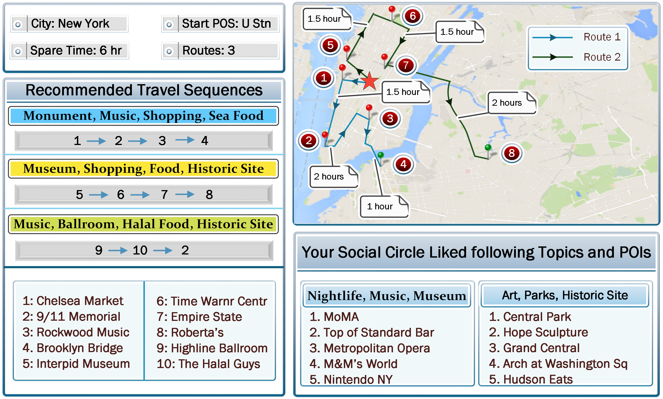
Visual Interface for Travelers

Slide 11
Datasets
Tweets with Foursquare check-ins from March-July 2014
Using the embedded URLs in Tweets and Foursquare API:
POI Information: rating, popularity, description, category etc.
User Information: friends, number of check-ins, and lists
City | # users | # POIs | MnChk | Mn Frns | Mn Cats
NY | 1521 | 2076 | 10.75 | 10.04 | 17.14
Moscow | 1132 | 1574 | 13.05 | 5.80 | 9.36
LA | 794 | 976 | 8.51 | 9.37 | 13.45
Chicago | 822 | 1079 | 8.9 | 7.4 | 13.36

Slide 12
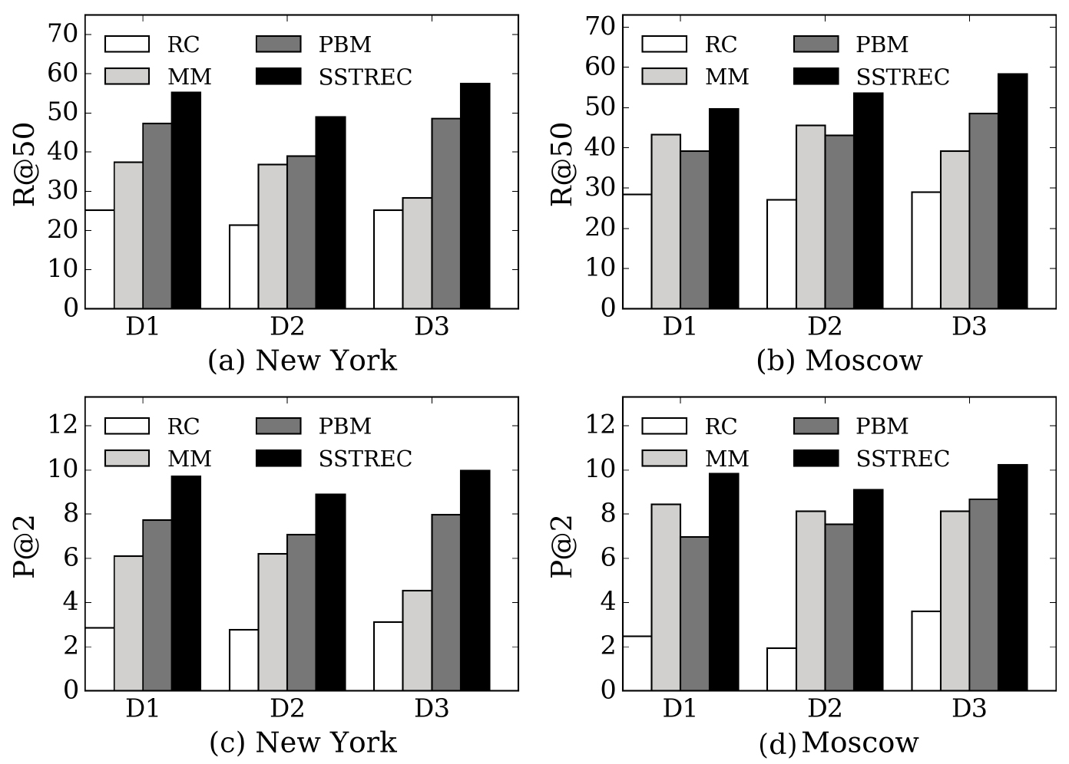
Results
Baselines:
Random Multinomial Choice (RC): choosing POI randomly according to popularity
Markov Model (MM): predict the most likely next POI given the current one
Photographer Behavior Model (PBM): combines Markov model and PLSA

Slide 13
Contributions
Semi-supervised probabilistic generative framework:
takes into account popularity of POIs, topical interests of users and their friends
allows to incorporate traveler and POI-specific features as priors
Algorithm for POI sequence recommendation under multiple constraints
State-of-the-art performance on real-life dataset

Slide 14
Thank you! Questions?

